Slide 1
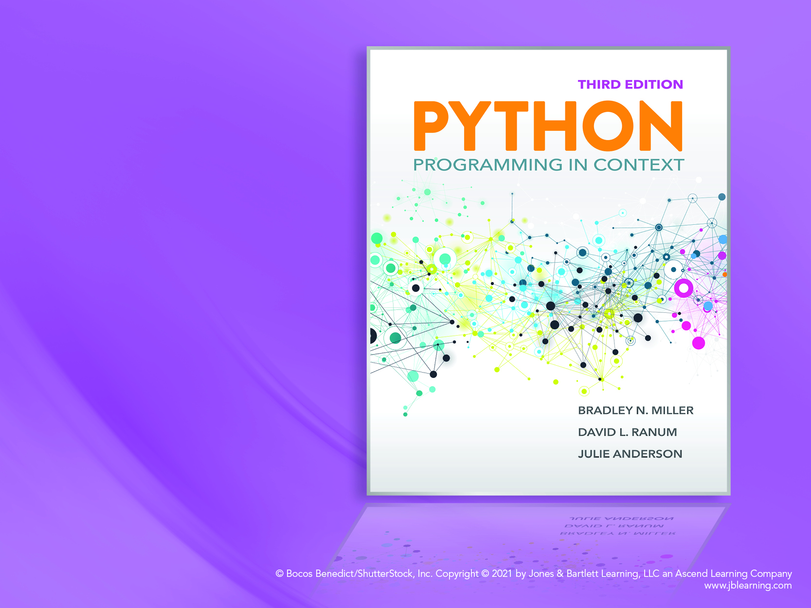
Chapter 8
Cryptanalysis

Slide 2
Objectives
To understand more advanced examples of using a dictionary in Python
To understand more advanced examples of using lists in Python
To use pattern matching with regular expressions
To learn how simple programs can help you solve more advanced problems

Slide 3
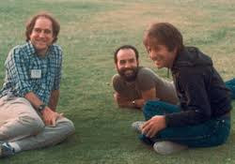
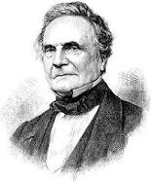
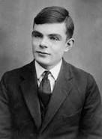
Cryptanalysis
Code Breaking
RSA: state of the art cryptography algorithm
Invented by Ron Rivest, Adi Shamir, Leonard Adleman
Charles Babbage, working on breaking Vigenere
Alan Turing, breaking German Enigma cipher in WW II
The imitation game, the full movie here; from 1:11-1:18:20)
Brute force
Try all possibilities
Frequency Analysis
Help to find correct decoding
Word Dictionary
Help to discover “real” words

Slide 4
Breaking Rail Fence
Try all possible numbers of rails
Look for the most real words

Slide 5
Create Word Dictionary (Listing 8.1)
#use with wordlist.txt
def createWordDict(dName):
myDict = {}
with open(dName, 'r') as myFile:
for line in myFile:
myDict[line[:-1]] = True #set values to True
return myDict

Slide 6
Brute Force Attempt (Listing 8.2)
def railBreak(cipherText):
wordDict = createWordDict('wordlist.txt')
cipherLen = len(cipherText)
maxGoodSoFar = 0
bestGuess = "No words found in dictionary" #default response
for i in range(2, cipherLen + 1):
words = railDecrypt(cipherText, i)
goodCount = 0 #reset for new list
for w in words:
if w in wordDict:
goodCount = goodCount + 1
if goodCount > maxGoodSoFar: #if more words in this list
maxGoodSoFar = goodCount
bestGuess = " ".join(words) #join words in list with space
return bestGuess

Slide 7
railDecrypt (Listing 8.3)
def railDecrypt(cipherText, numRails):
railLen = len(cipherText) // numRails
solution = ''
for col in range(railLen):
for rail in range(numRails):
nextLetter = col + (rail * railLen)
solution = solution + cipherText[nextLetter]
return solution.split()

Slide 8
Letter Frequency Analysis
How often does each letter appear in a large text?
Assumption: Representative for all texts
Use that information to help decode

Slide 9
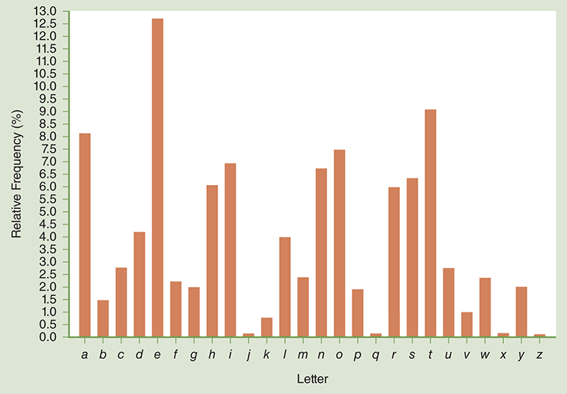
Letter Frequency (Figure 8.1)

Slide 10
Dictionary Counts Letter Frequency (Listing 8.4)
def letterFrequency(text):
text = text.lower()
nonLetters = removeMatches(text, 'abcdefghijklmnopqrstuvwxyz')
text = removeMatches(text, nonLetters)
lCount = {}
total = len(text)
for ch in text: #count each letter’s occurrence
lCount[ch] = lCount.get(ch, 0) + 1
for ch in lCount: #calculate percentages
lCount[ch] = lCount[ch] / total
return lCount

Slide 11
Neighbor Analysis
Which letters appear most frequently next to another letter?
Help to distinguish between common letters
Approach:
1. Rather than count the number of times each letter occurs, we want to keep a list of neighboring letters. This list will contain all the letters that appear before or after the letter in question.
2. The output of the function will be a dictionary that contains a key for each letter of the alphabet and a list of neighboring letters.
3. We need to be careful about how we account for nonletters in our counting. If we simply delete nonletters as we did previously, we will end up creating false neighbors.

Slide 12
Add letter only if not on the list already (Listing 8.6)
def maybeAdd(ch, toList):
if ch in 'abcdefghijklmnopqrstuvwxyz’ and ch not in toList:
toList.append(ch)

Slide 13
Counting Neighbors (Listing 8.7)
def neighborCount(text):
nbDict = {}
text = text.lower()
for i in range(len(text) - 1):
nbList = nbDict.setdefault(text[i], [])
maybeAdd(text[i + 1], nbList)
nbList = nbDict.setdefault(text[i + 1], [])
maybeAdd(text[i], nbList) for key in nbDict.keys(): #replace letters list with count
nbDict[key] = len(nbDict.get(key))
return nbDict

Slide 14
Listing 8.9
def maybeAdd(ch, toDict):
if ch in 'abcdefghijklmnopqrstuvwxyz':
toDict[ch] = toDict.setdefault(ch,0) + 1

Slide 15
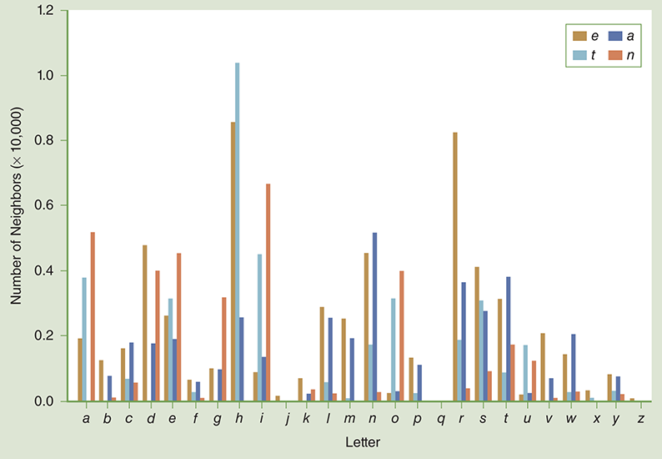
Pair Frequencies for a, e, n, and t (Figure 8.2)

Slide 16
Word Frequency Analysis
Sort words in ciphertext by word size
Listing 8.10:
def sortByLen (w)
return len(w)

Slide 17
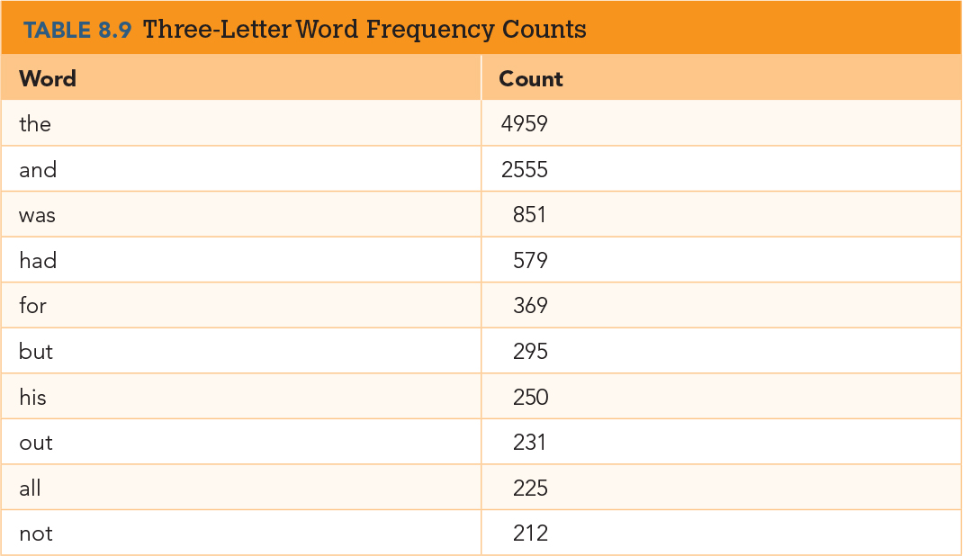
Popular 3-letter Words

Slide 18
Regular Expressions
Pattern matching library
Wildcards
Letter replacement

Slide 19
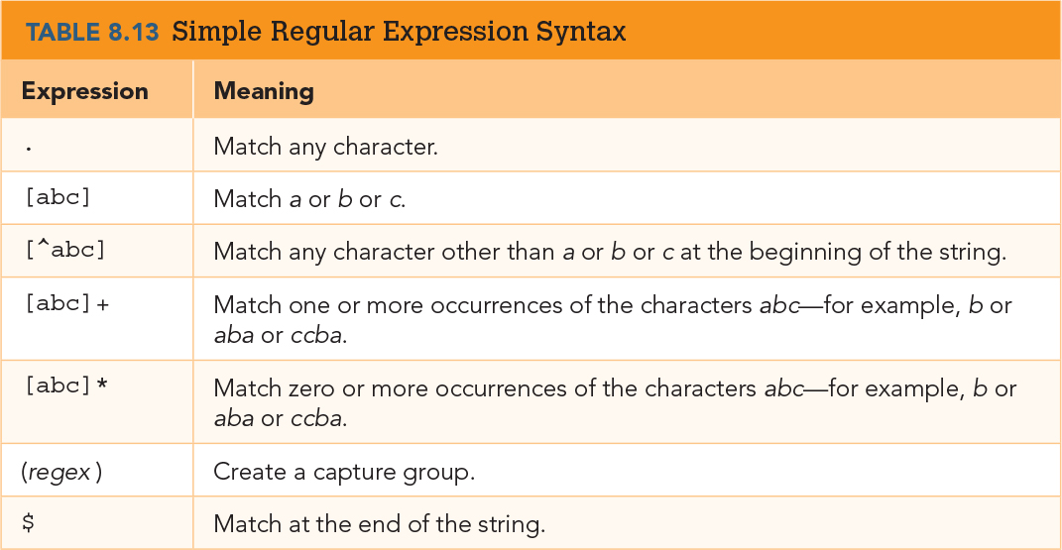
Regular Expression Syntax

Slide 20
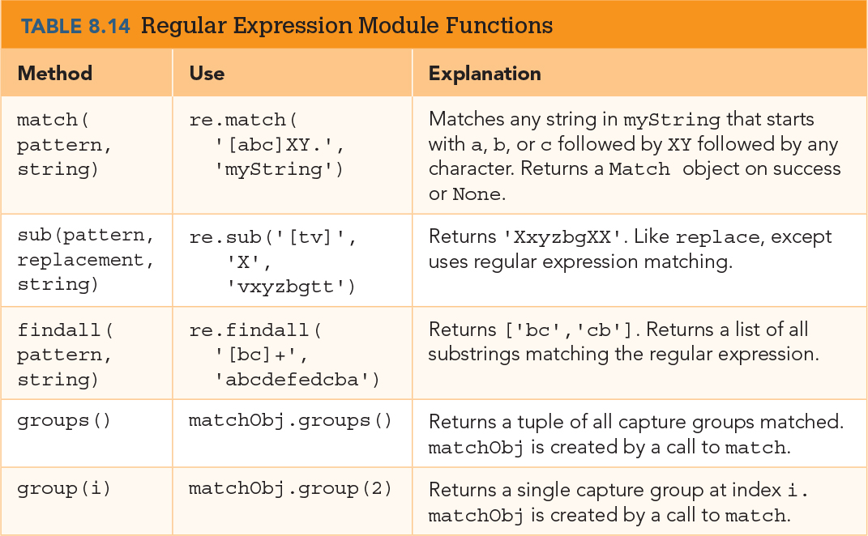
RE Module Methods

Slide 21
Matching Words (Listing 8.11)
>>> import re
>>> def checkWord(regex):
resList = []
with open('wordlist.txt', 'r') as wordFile:
for line in wordFile:
if re.match(regex, line[:-1]):
resList.append(line[:-1])
return resList

Slide 22
Matching with Unused Letters (Listing 8.12)
def checkWord(unused, pattern):
resList = []
with open('wordlist.txt', 'r') as wordFile:
rePat = '['+unused+']'
regex = re.sub('[a-z]', rePat, pattern) + '$'
regex = regex.lower()
print('matching', regex)
for line in wordFile:
if re.match(regex, line[:-1]):
resList.append(line[:-1])
return resList

Slide 23
Show Matching Letters (Listing 8.13)
def findLetters(unused, pattern):
resList = []
with open('wordlist.txt', 'r') as wordFile:
ctLetters = re.findall('[a-z]', pattern)
print(ctLetters)
rePat = '(['+unused+'])'
regex = re.sub('[a-z]', rePat, pattern) + '$'
regex = regex.lower()
for line in wordFile:
myMatch = re.match(regex, line[:-1])
if myMatch: #if not None
matchingLetters = myMatch.groups()
matchList = []
for l in matchingLetters:
matchList.append(l.upper())
resList.append(line[:-1])
resList.append(list(zip(ctLetters, matchList)))
return resList

